Slide 1
Web Media
Chapter 7

Slide 2
Objectives
1
2
Digital Representation
Color
Models
3
4
Image Concepts
File Formats
5
6
Audio and Video
HTML5 Canvas
7

Slide 3
Digital Representation of Images
Section 1 of 6

Slide 4
Digital Representation
Of Images
When you see text and images on your desktop monitor or your mobile screen, you are seeing many small squares of colored light called pixels that are arranged in a two-dimensional grid.
These same images and text on the printed page are not created from pixels, but from small overlapping dots usually called halftones

Slide 5
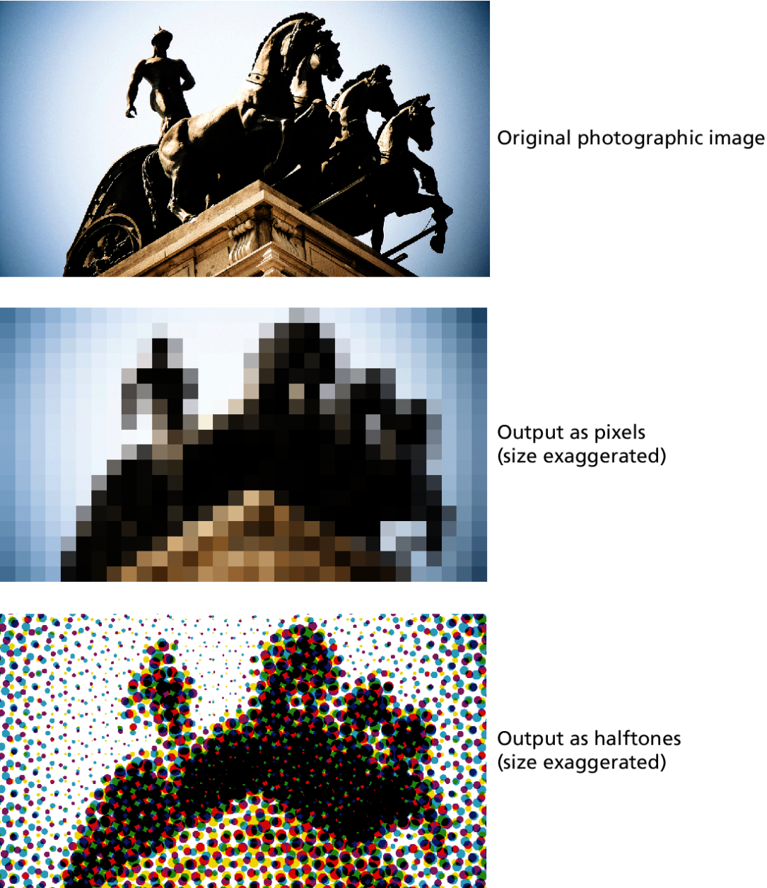
Digital Representation
Of Images

Slide 6
Digital Representation
Of Images
Digital representation ultimately refers to representing information as numbers
text characters are digitally represented using standardized 8-bit (ASCII) or 16-bit (UNICODE) numbers
Finite # of text characters, infinite pictures…

Slide 7
Digital Representation
Of Images
Two basic categories of image
Raster (a.k.a. bitmap)
the image is broken down into a two-dimensional grid of colored squares
Vector
composed of objects such as lines, circles, Bezier curves, and polygons

Slide 8
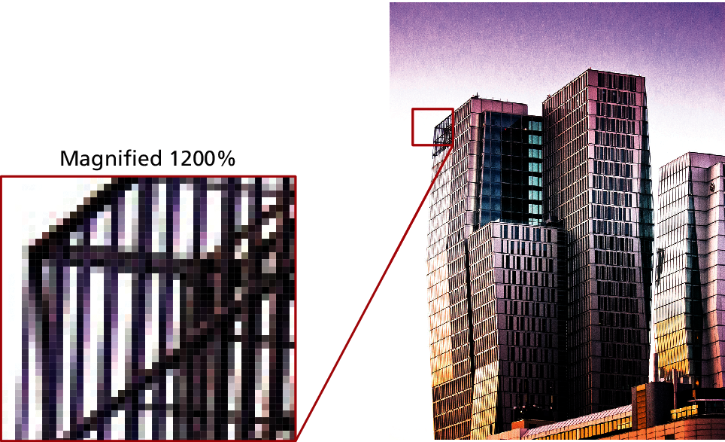
Raster Image
A close up

Slide 9
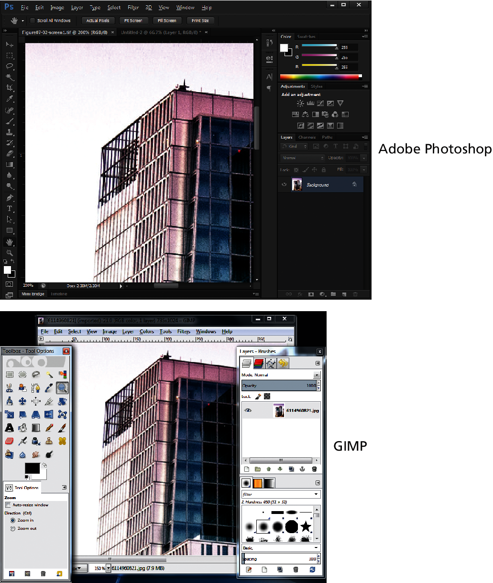
Raster Image
Raster Image Editors

Slide 10
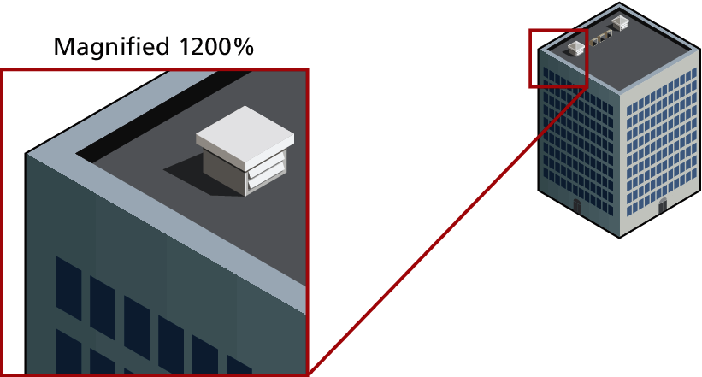
Vector Images
An Example
The main advantage of vector images is that they can be shrunken or enlarged without a loss of quality

Slide 11
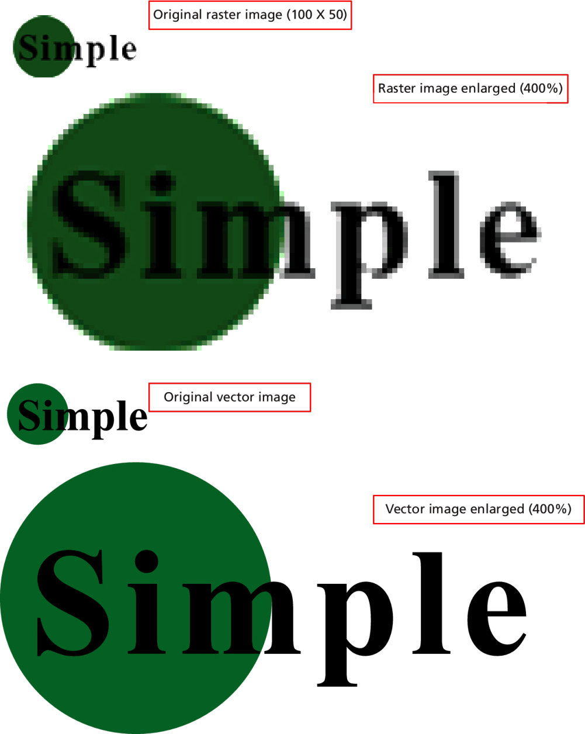
Vector vs Raster
Examples

Slide 12
Color models
Section 2 of 6

Slide 13
Multiple Models
There are a variety of different ways to specify color on the web.
Named Colours
RGB (Red Green and Blue)
CMYK (Cyan-Magenta- Yellow-Key (or blacK))
HSL/HSB (Hue, Saturation, Lightness/Brightness)

Slide 14
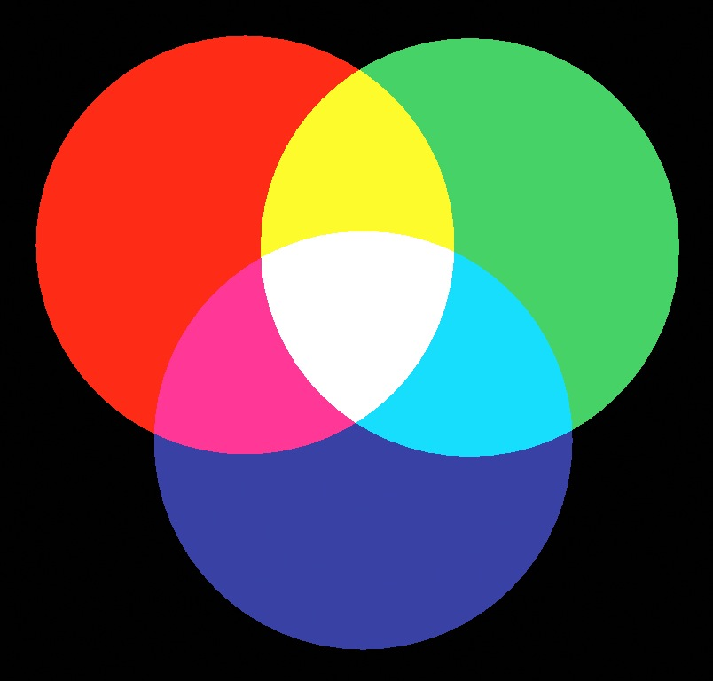
RGB
That shirt is a nice #33CA8F color.

Slide 15
RGB
How to represent
6 Digit Hexadecimal notation
#RRGGBB, where each digit 0-F hex
Example #FF0000
CSS rgb function
Rgb(red, green, blue), values 0-255
Example rgb(255, 0, 0);

Slide 16

RGB
A Little color theory
Because the RGB colors combine to create white, they are also called additive colors.
The absence of colored light is black
Adding all colors together creates white.

Slide 17
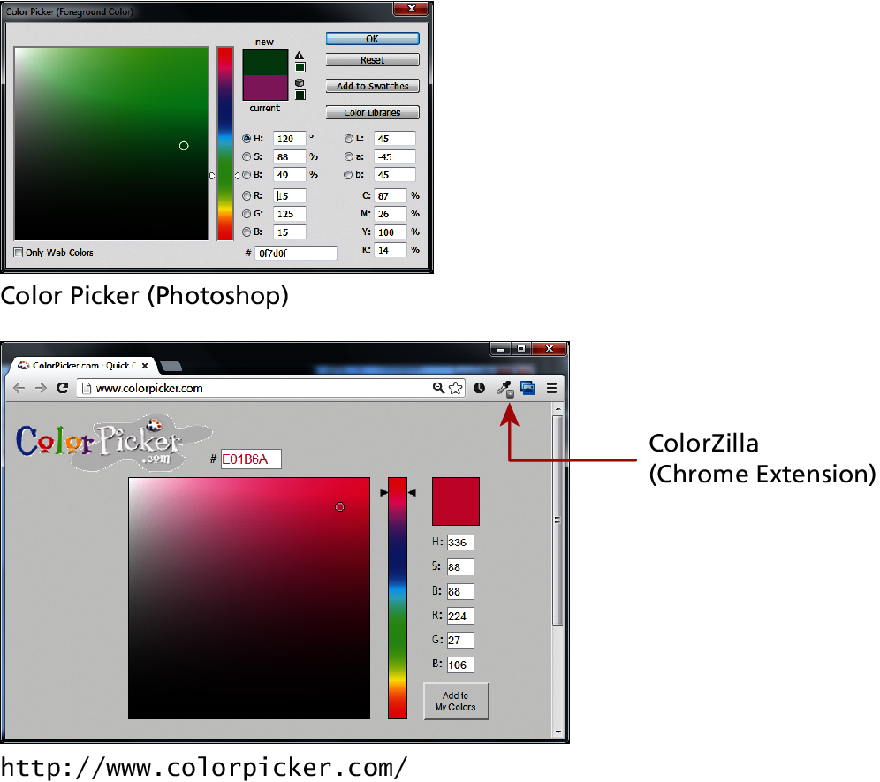
RGB
How to choose

Slide 18
CMYK
not every image will be displayed on an RGB device
In traditional color printing, color is created through overlapping cyan, magenta, yellow, and black dots that from a distance create the illusion of the combined color. For this a different color model is necessary, namely
CMYK color model for Cyan-Magenta Yellow-Key (or blacK).

Slide 19
CMYK
For printers

Slide 20
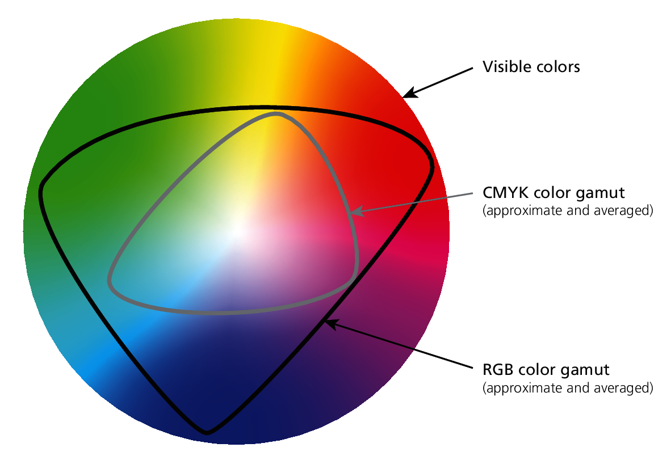
Gamut
The range of colors that a color system can display or print

Slide 21
HSL/HSB
Hue, Saturation, Brightness(HSB) or Lightness(HSL)
is more closely aligned to the way we generally talk about color. It breaks a color down into three components:
hue (what we generally refer to as color)
saturation (the intensity or strength of a color
Lightness/brightness (that is, the relative lightness or darkness of a color)

Slide 22
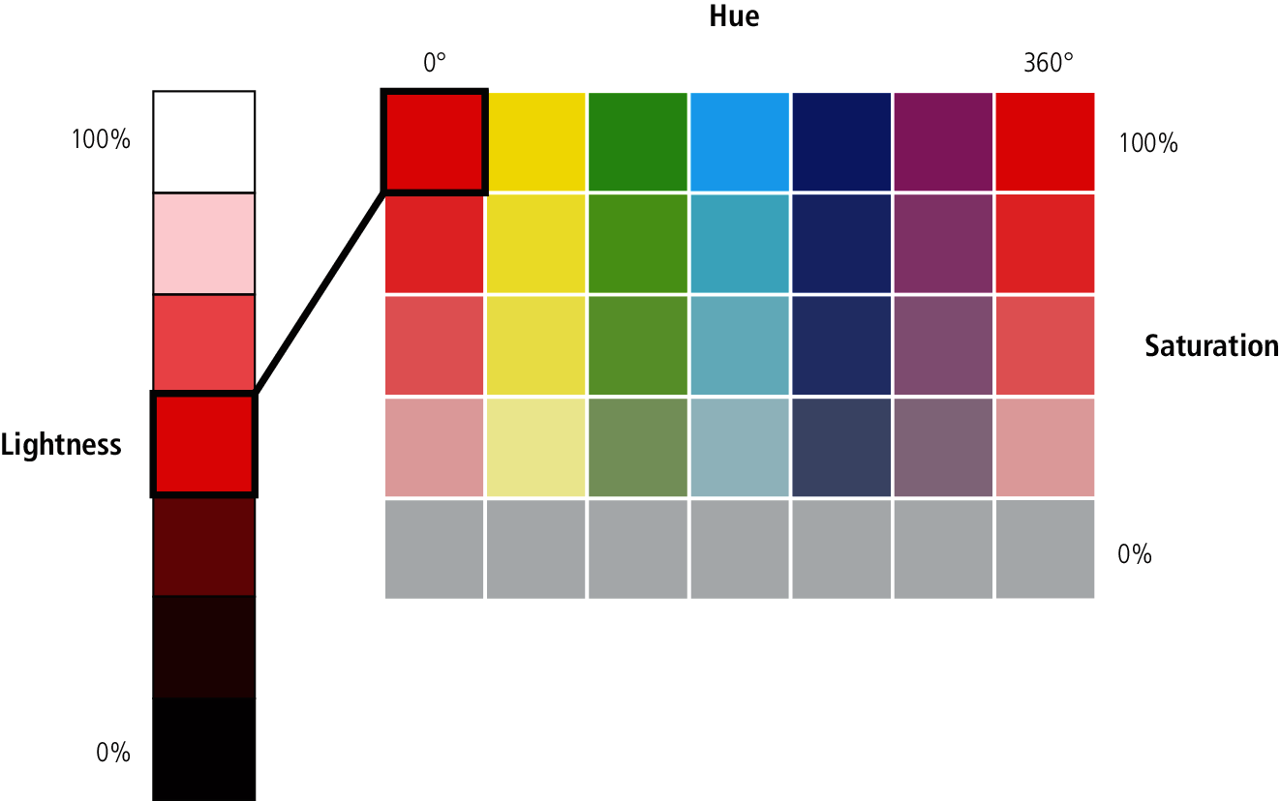
HSL/HSB

Slide 23
HSL
CSS3 Support
CSS3 has support for the HSL model using the notation:
hsl(hhh, ss%, bb%)
hue is an angle between 0 and 360 (think of hue as a circle)
saturation is a percentage between 0 and 100, where 0% is completed desaturated (grey) while 100% is fully saturated.
Brightness/lightness is a percentage between 0 and 100, with 0 percent being pure dark (black), and 100 percent being pure bright (white)

Slide 24
Opacity
I can see right through you
Opacity is the degree of transparency in the color. This value is also referred to as alpha transparency.
Opacity is typically a percentage value between 0 and 100 (or between 0 and 1.0)
0 means no opacity (transparent)
100 means that the element is fully opaque (no transparency).
You can also add opacity values to a color specification using the rgba() or hsla()

Slide 25
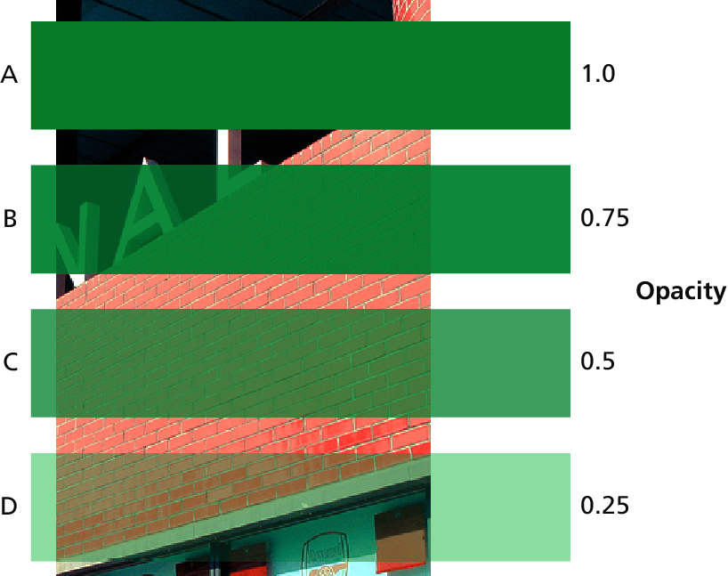
Opacity
Transparency

Slide 26
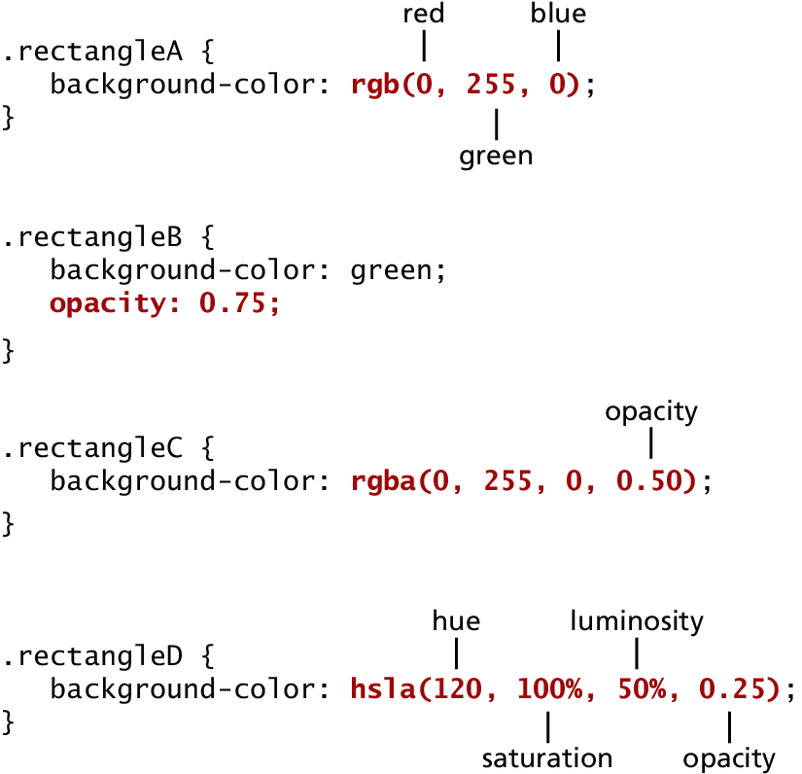
Opacity
In CSS

Slide 27
Color Relationships
But that is a nice #33CA8F shirt
Humans do not dispassionately register a color’s hue, saturation, and brightness. Instead we see colors in relationship to other colors.
the way we perceive a color changes based on the other colors that are in close proximity.
colors can evoke certain emotions and impressions, many of which are culturally determined
Artists often use the color wheel, and more sophisticated mechanisms, to help understand and work with color

Slide 28
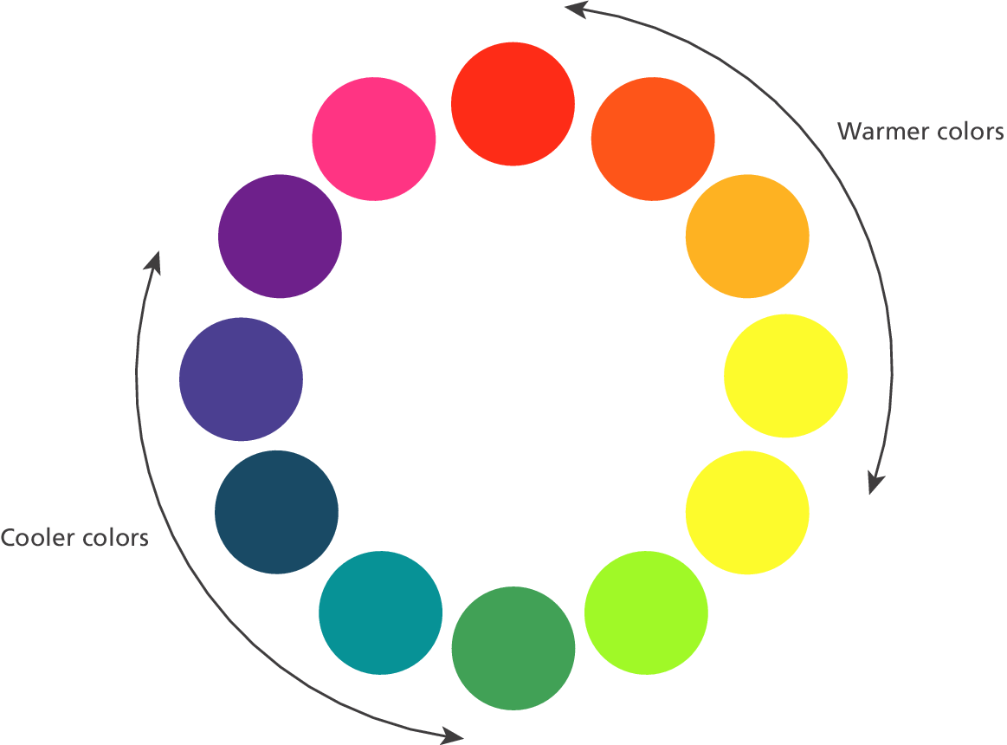
Color Relationships
Color Wheel

Slide 29
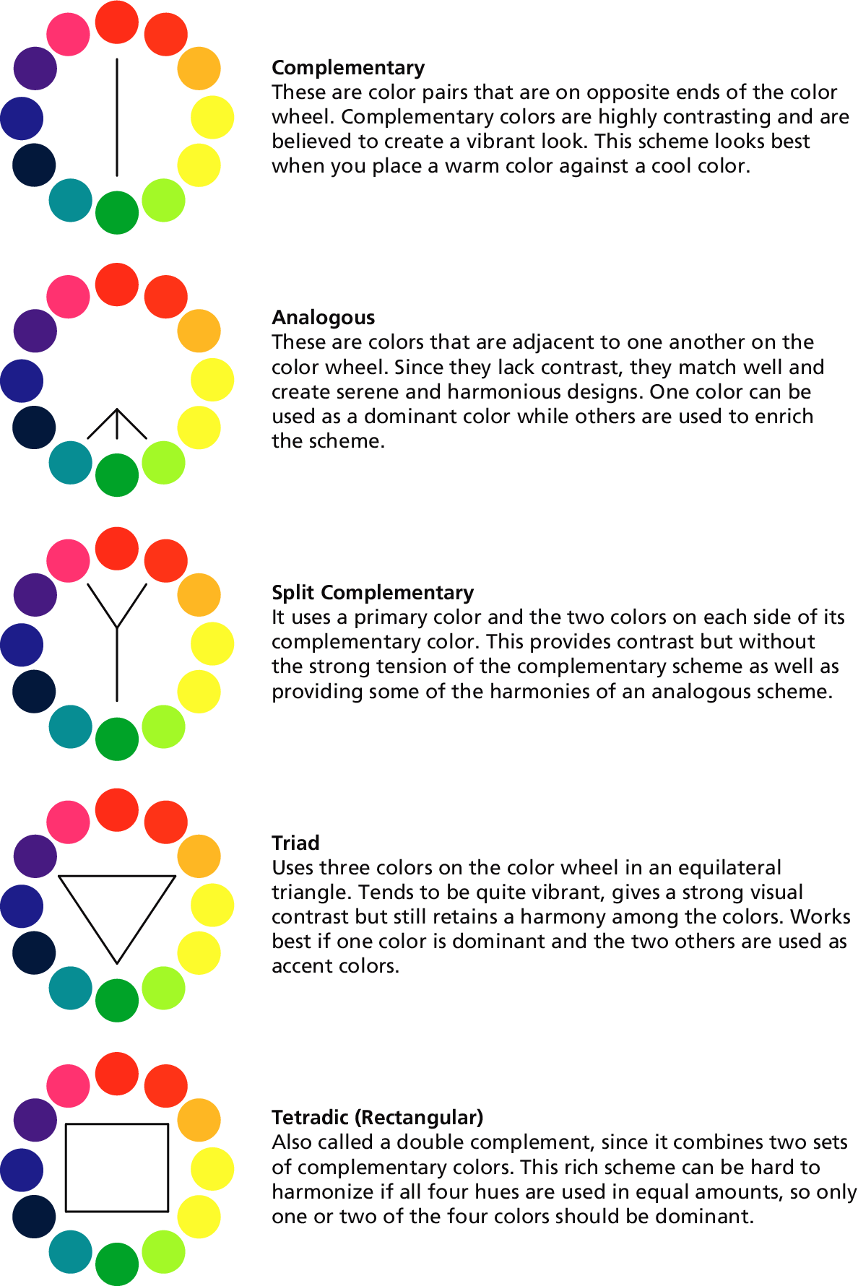
Color Relationships
Ways of picking color

Slide 30
Color Relationships
A few more

Slide 31
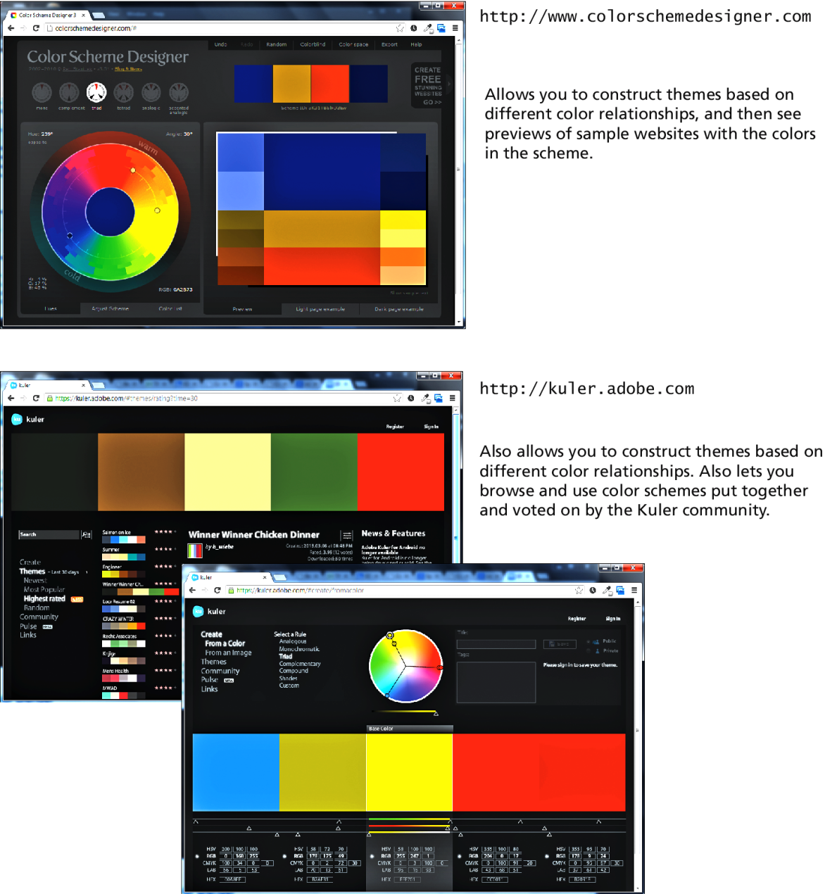
Color Relationships
A few online tools

Slide 32
Color Relationships
Some Conclusions
The point here is that the colors you use in a website should not be chosen at random, but should work together in some manner.
Programmers are not always the best judges of good color combinations.
Sometimes you will have a visual designer who will handle these decisions.
But for smaller projects, you may need to make those decisions yourself. Use the Tools!!!

Slide 33
Image Concepts
Section 3 of 6

Slide 34
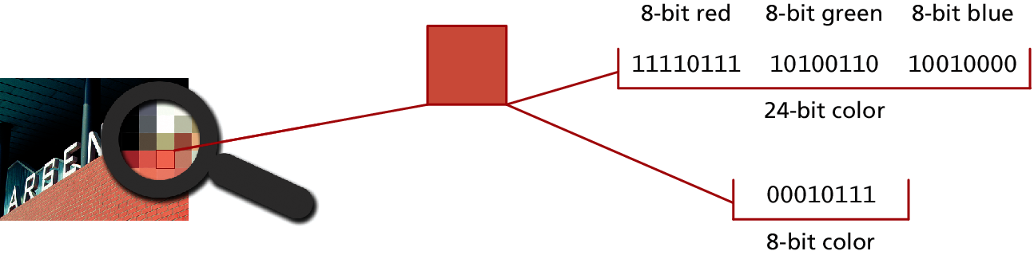
Color Depth
Color depth refers to the maximum number of possible colors that an image can contain.
For raster images, this value is determined by the number of bits used to represent the color or tone information for each pixel in the image

Slide 35
Color Depth
# Bits / Pixel | Description
8 bits or less | Sometimes referred to as indexed color. No more than 2⁸ or 256 colors can be represented. Using 7 bits per pixel would allow only 128 colors, 6 bits per pixel would allow only 64 colors, 5 bits = 32 colors, 4 bits=16 colors, 3 bits = 8 colors, 2 bits = 4 colors, and 1 bit = 2 colors.
24 bits | Also called true color. 16.8 million colors can be represented. Eight bits each are used for red, green, and blue information.
32 bits | Same as 24 bit, but 8 bits of alpha transparency information is added.
48 bits | 16 bits per red, green, and blue. While not supported in browsers, these deep color image depths are supported by specialized photo editing software.

Slide 36
Color Depth
Your output device has limits too
Image color depth is not the same thing as device color depth, which refers to the number of simultaneous colors a device can actually display.
Most home and business-class LCD monitors are in fact often only 18-bit display devices (262,144 colors)
LCD monitors that can display true 24-bit color are more expensive

Slide 37
Color Depth
Your output device has limits too
Image color depth is not the same thing as device color depth, which refers to the number of simultaneous colors a device can actually display.
Most home and business-class LCD monitors are in fact often only 18-bit display devices (262,144 colors)
LCD monitors that can display true 24-bit color are more expensive

Slide 38
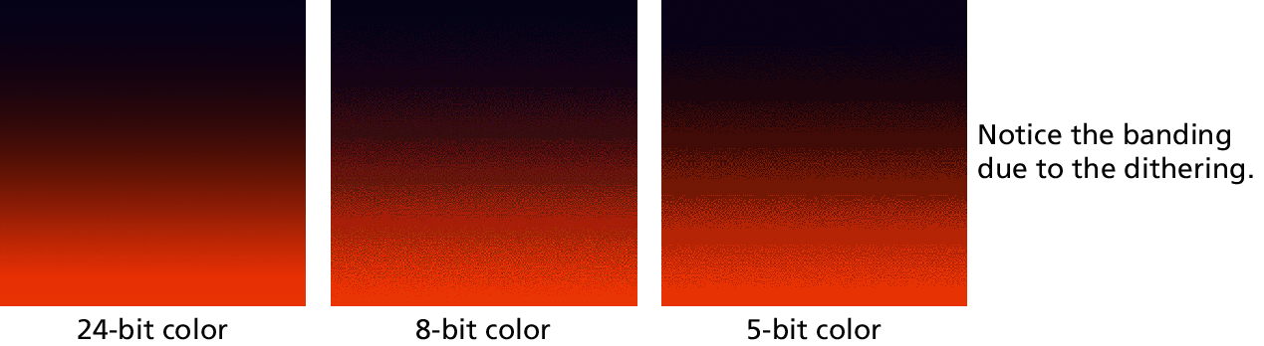
Dithering
Monitors limited to less than true color create the illusion of more colors by dithering the available colors in a diffuse pattern of pixels

Slide 39
Image size
How big is this raster?
image size refers to how many pixels it contains,
Usually pixels wide x pixels high
Notice that you do not use real-world measurement units. The size of an image on-screen is determined by
the pixel dimensions of the image,
the monitor size, and
the computer’s display resolution,
only one of which is at the control of the web designer

Slide 40
Image resize
Interpolate
Image size refers to how many pixels it contains,
Usually pixels wide x pixels high
Notice that you do not use real-world measurement units. The size of an image on-screen is determined by
the pixel dimensions of the image,
the monitor size, and
the computer’s display resolution,
only one of which is at the control of the web designer

Slide 41
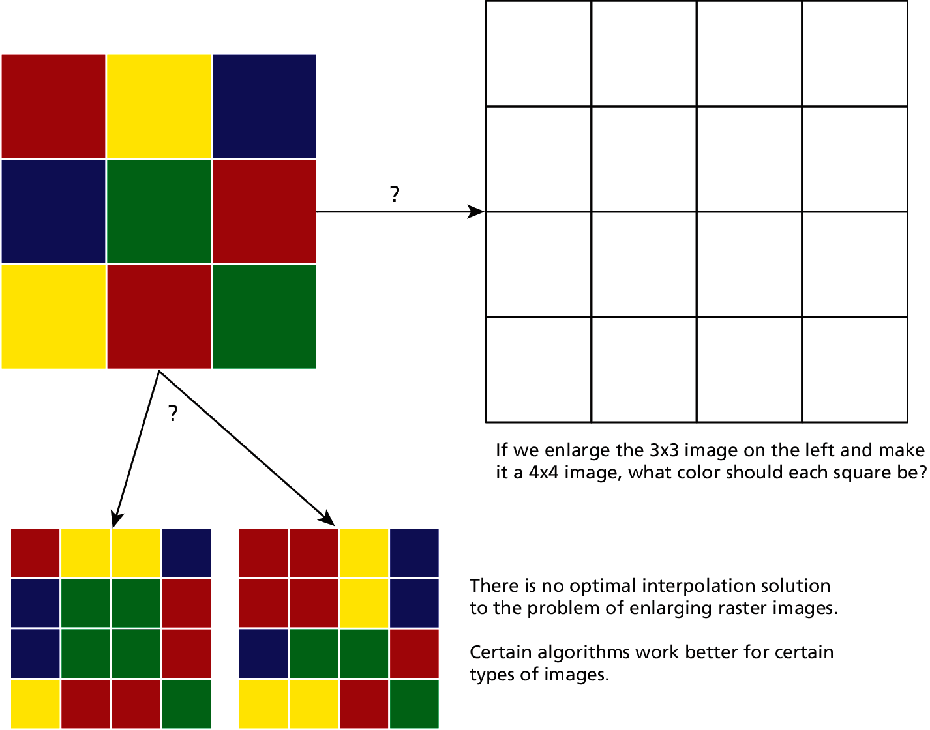
Interpolate
Add or remove pixels due to resizing

Slide 42
Interpolate
Whenever you resize (either larger or smaller) a raster image, the program doing the resizing must interpolate
Making an image larger degrades the image much more than making it smaller
increasing the size just a small percentage (say 10–20%) may likely result in completely satisfactory results

Slide 43
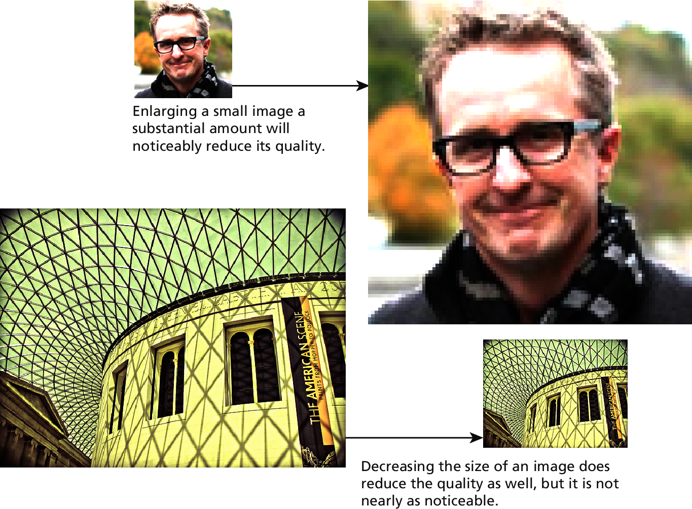
Enlarging and Reducing

Slide 44
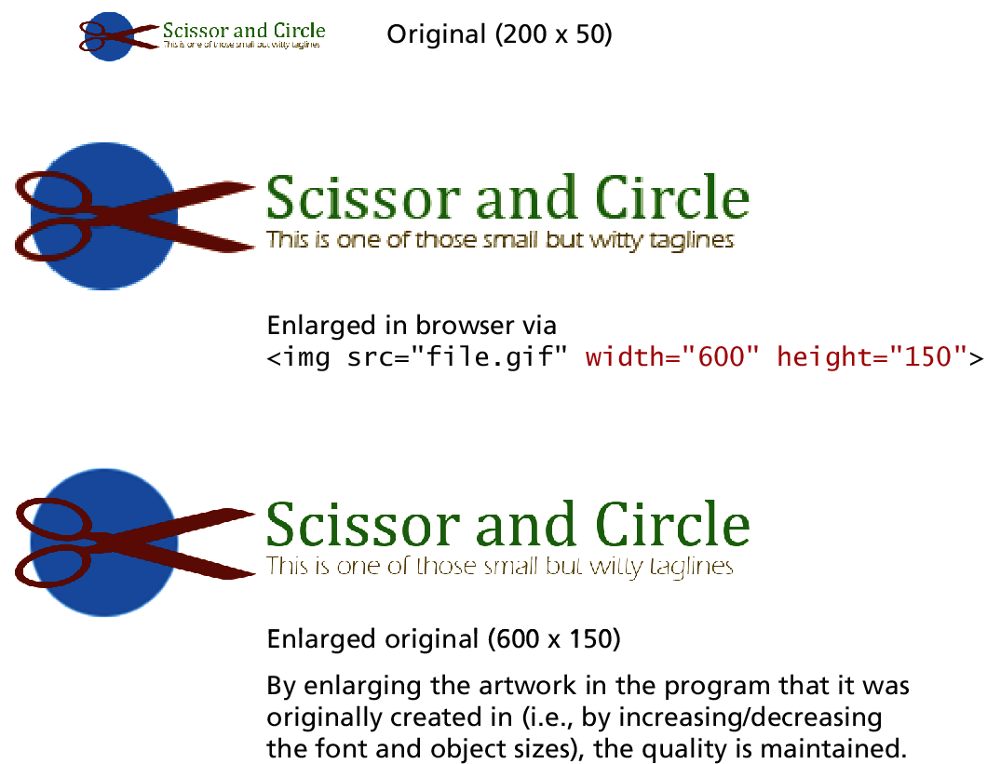
The browser is fast
But not the best looking, resize in photo editors
The best way to change the size of a nonphotographic original is to make the change in the program that created it.

Slide 45
The browser is fast
But not the best looking, resize in photo editors
The best way to change the size of a nonphotographic original is to make the change in the program that created it.

Slide 46
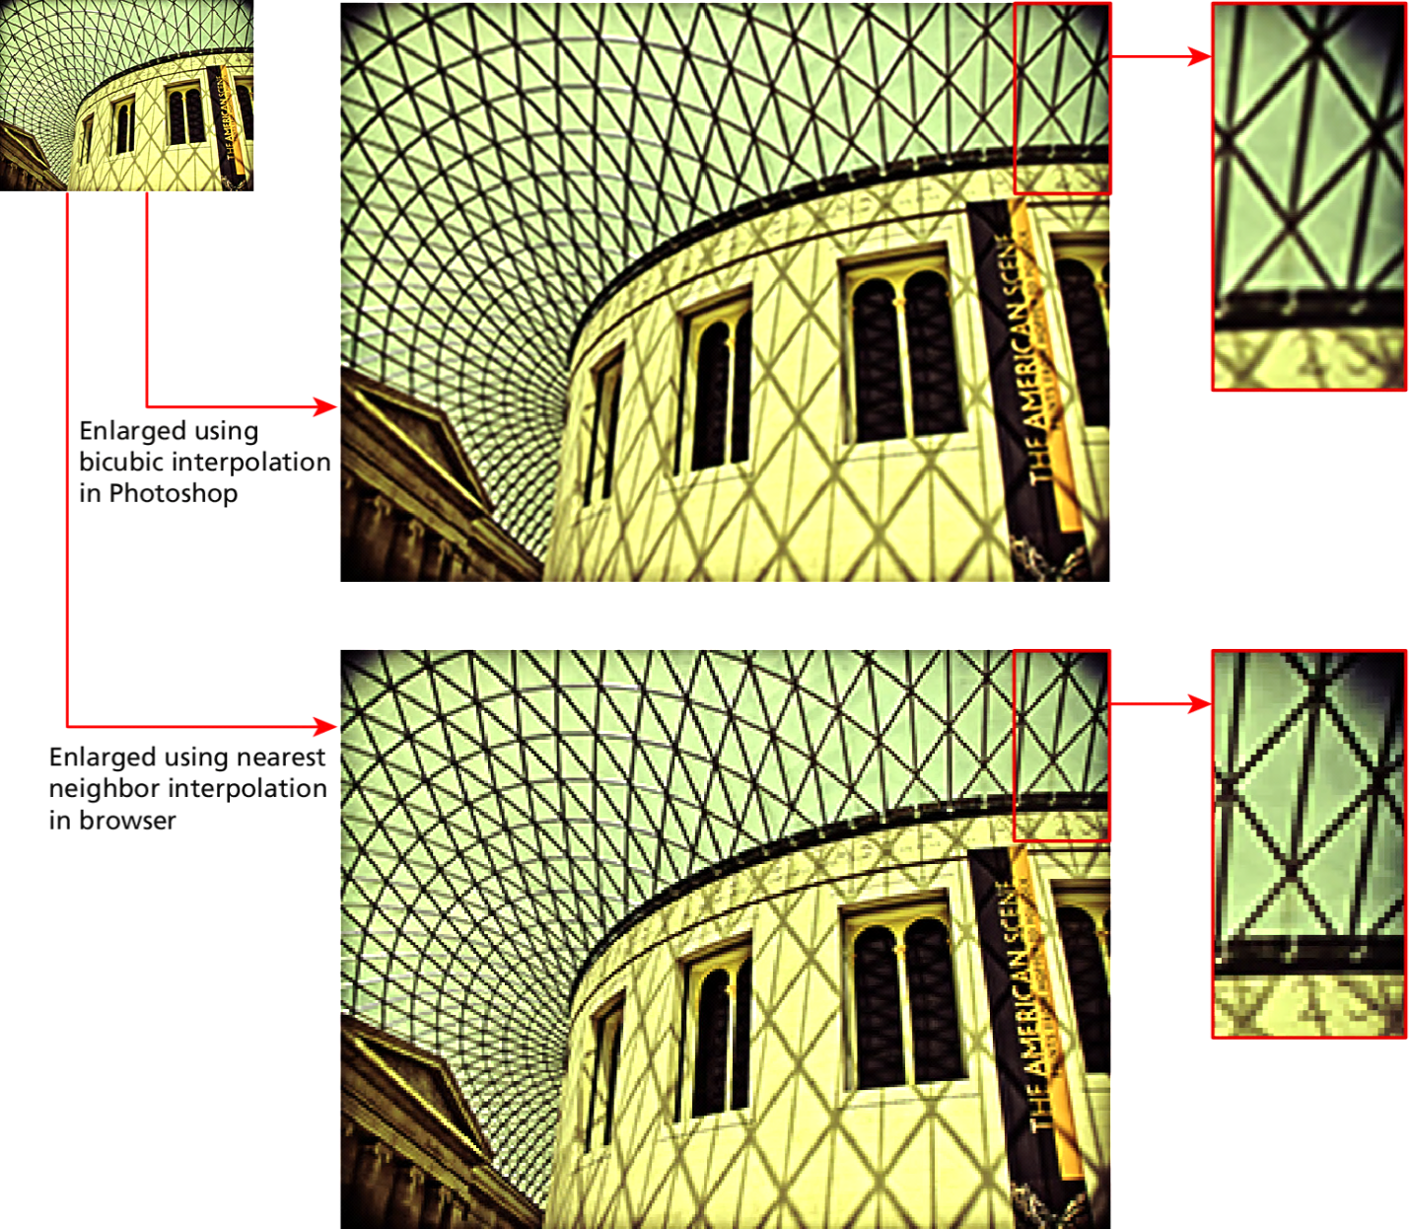
The browser is fast
But not the best looking, resize in photo editors

Slide 47
Display Resolution
The display resolution refers to how many pixels a device can display.
Like image size, it is expressed in terms of the number of pixels horizontally by the number of pixels vertically. Some common display resolutions include:
1920 x 1600 px
1280 x 1024 px
1024 x 768 px
320 x 480 px

Slide 48
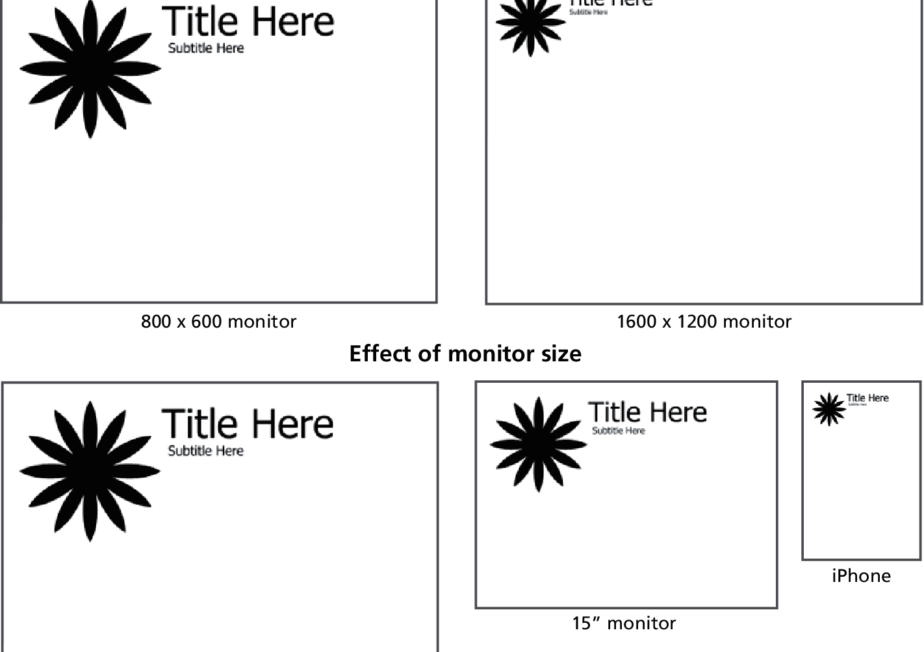
Display Resolution
Vs monitor size

Slide 49
High Density complication
With new high-density displays (such as iPad retina displays) if they used a one-to-one mapping between the pixels in an image to the pixels on the screen, images would be too small.
These devices use something called a reference pixel.
For the instance, the iPhone 4 has an actual physical display resolution of 640 x960 px, yet at the browser, from a reference pixel perspective, it claims it has a display resolution of 320 x 480 px.

Slide 50
File Formats
Section 4 of 6

Slide 51
File formats
Each with it’s own strengths
There a number of alternative file formats for images in web development.
JPEG
GIF
PNG
SVG

Slide 52
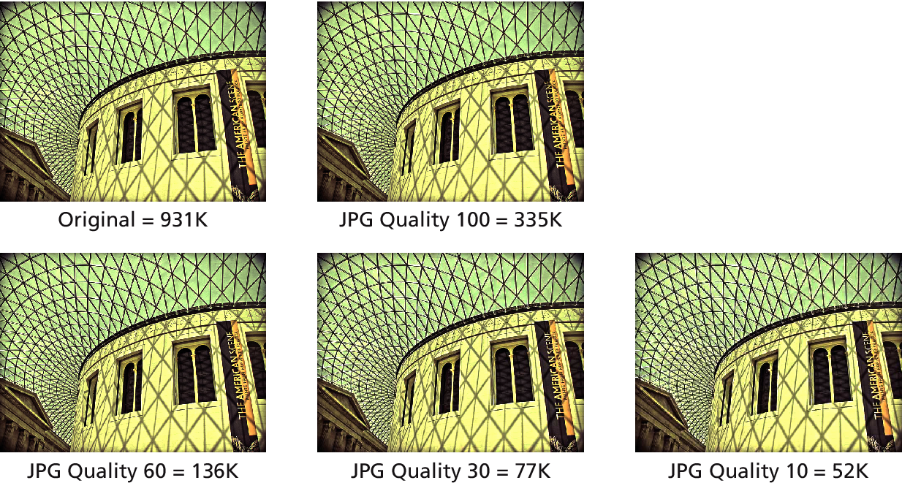
JPG
JPEG (Joint Photographic Experts Group) or JPG is a 24-bit, true-color file format that is ideal for photographic images. It uses a sophisticated compression scheme that can dramatically reduce the file size.

Slide 53
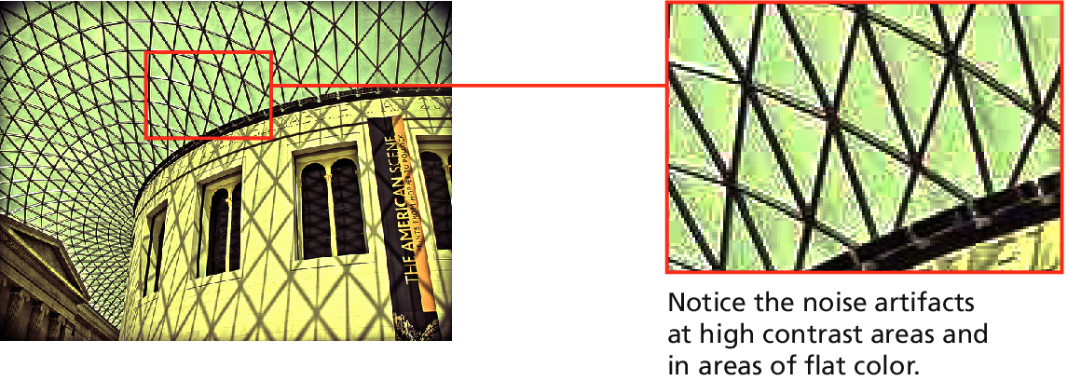
JPG
JPG is, however, a lossy compression scheme, meaning that it reduces the file size by eliminating pixel information with each save. At the highest levels of compression, you will begin to see blotches and noise (also referred to as artifacts) appear at edges and in areas of flat color

Slide 54
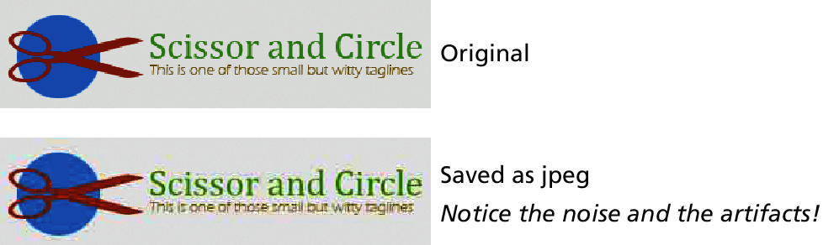
JPG
More artifacts

Slide 55
GIF
Good old GIF
The GIF (Graphic Interchange Format) file was the first image format supported by the earliest web browsers.
GIF is an 8-bit or less format, meaning that it can contain no more than 256 colors!
Great for Images with flat-bands of color, or with limited number of colors
Not very good for photographic images

Slide 56
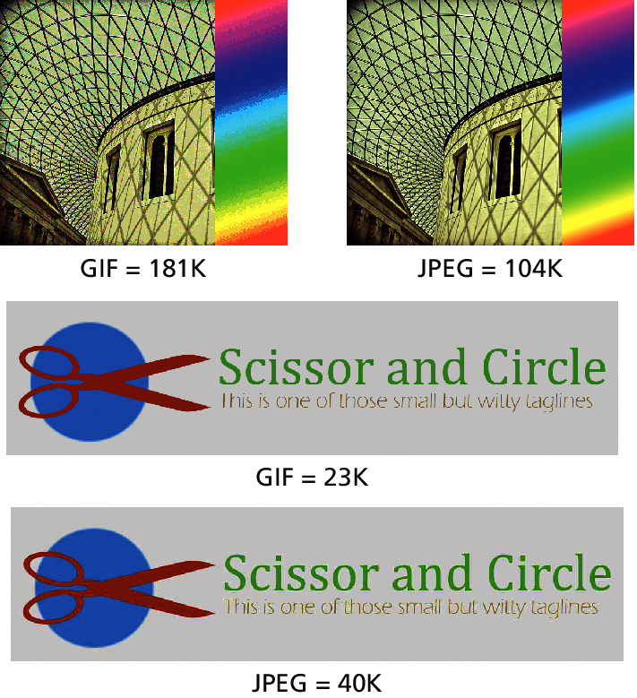
GIF
Good old GIF

Slide 57
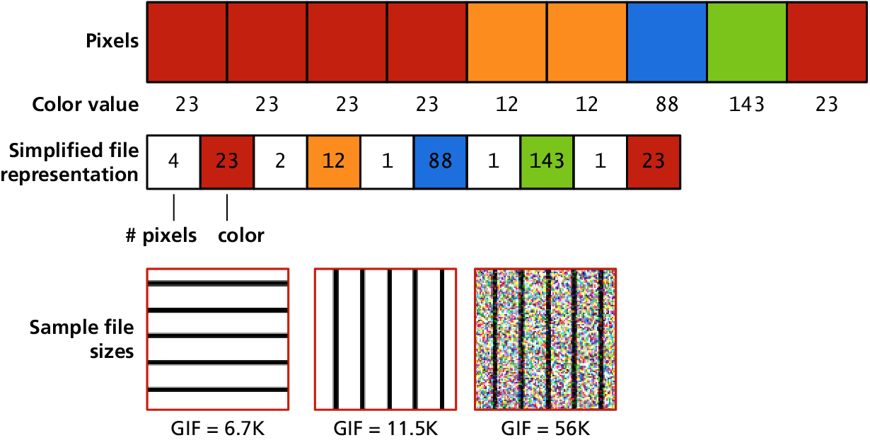
GIF
Good old GIF
The compression system is called run-length compression (also called LZW compression).

Slide 58
GIF
Color Palettes
The GIF file format uses indexed color, meaning that an image will have 256 or fewer colors.
You might be wondering which 256 (or fewer) colors?
Index color files dedicate 8 bits (or fewer) to each color pixel in the image.
Those 8 or fewer bits for each pixel reference a color that is described in a color palette

Slide 59
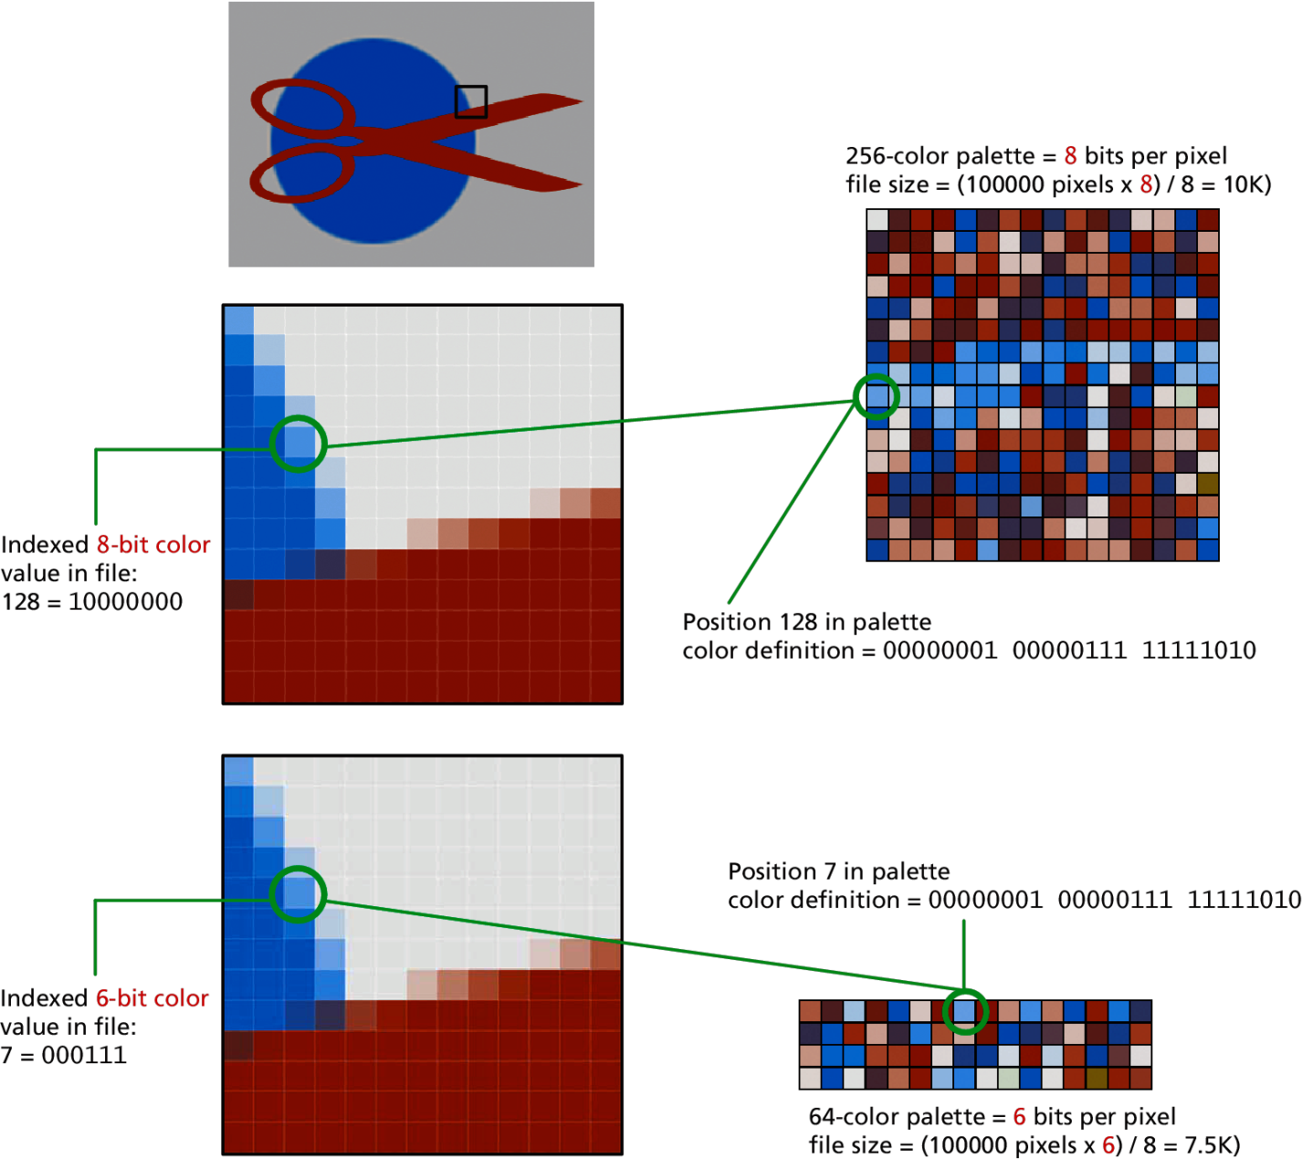
GIF
Color Palettes

Slide 60
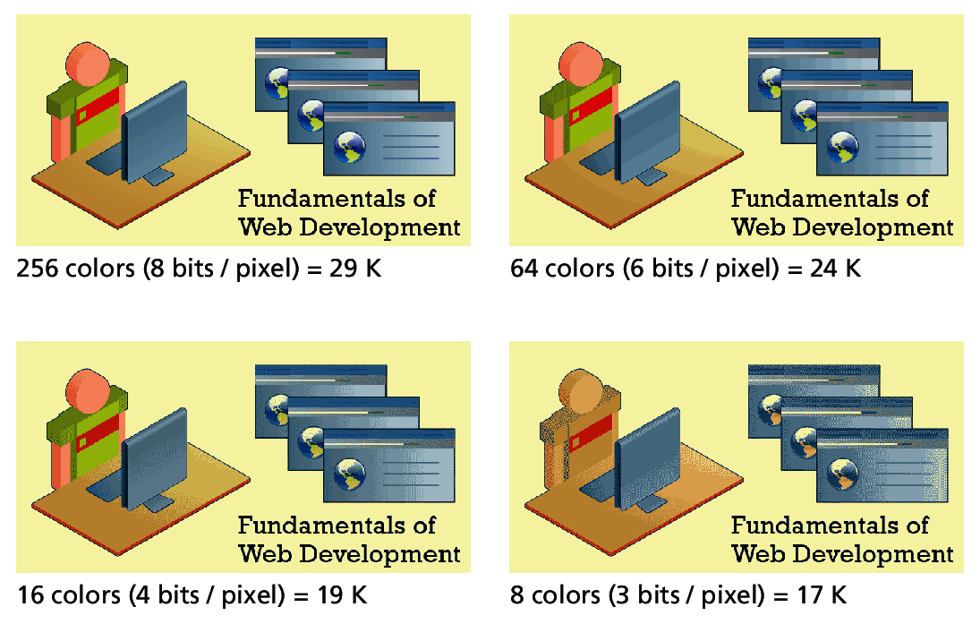
GIF
Optimizing
Optimizing GIF images is thus a trade-off between trying to reduce the size of the file as much as possible while at the same time maintaining the image’s quality.

Slide 61
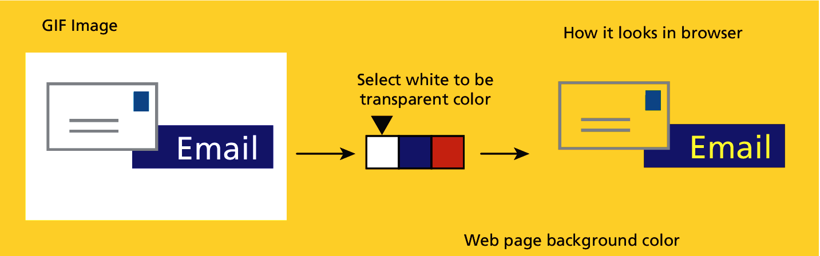
GIF
Transparency
One of the colors in the color lookup table (i.e., the palette) of the GIF can be transparent

Slide 62
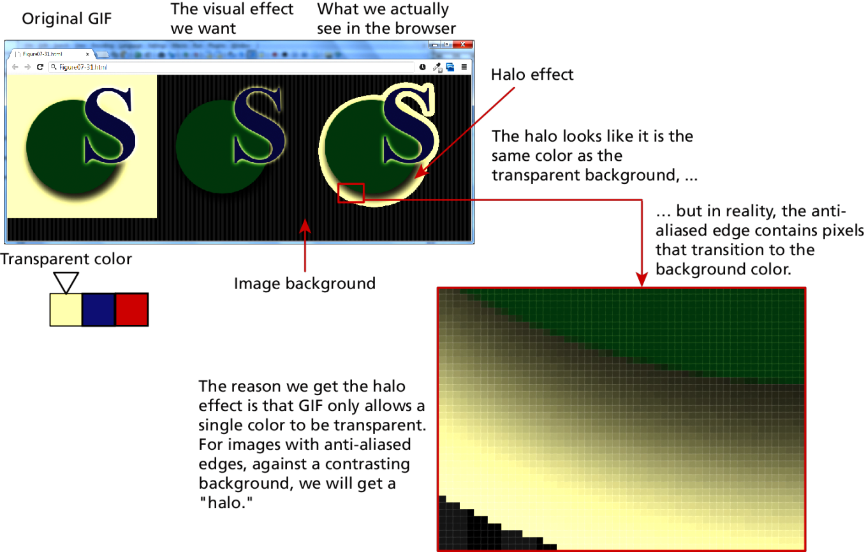
GIF
Transparency Trouble
Because GIF has only 1-bit transparency, transparent GIF files can also be disappointing when the graphic contains anti-aliased edges with pixels of multiple colors

Slide 63
GIF
Animation
Animations are created by having multiple frames, with each frame the equivalent of a separate GIF image.
GIF animations were de rigueur back in the middle 1990s, but are now mainly used only for advertisements or for creating retro-web experiences

Slide 64
PNG
The PNG (Portable Network Graphics) format is a more recent format. Its main features are:
Lossless compression.
8-bit (or 1-bit, 2-bit, and 4-bit) indexed color as well as full 24-bit true color (higher color depths are supported as well).
From 1 to 8 bits of transparency
This means that pixels can become progressively more and more transparent along an image’s anti-aliased edges, eliminating the transparency halo of GIF images

Slide 65
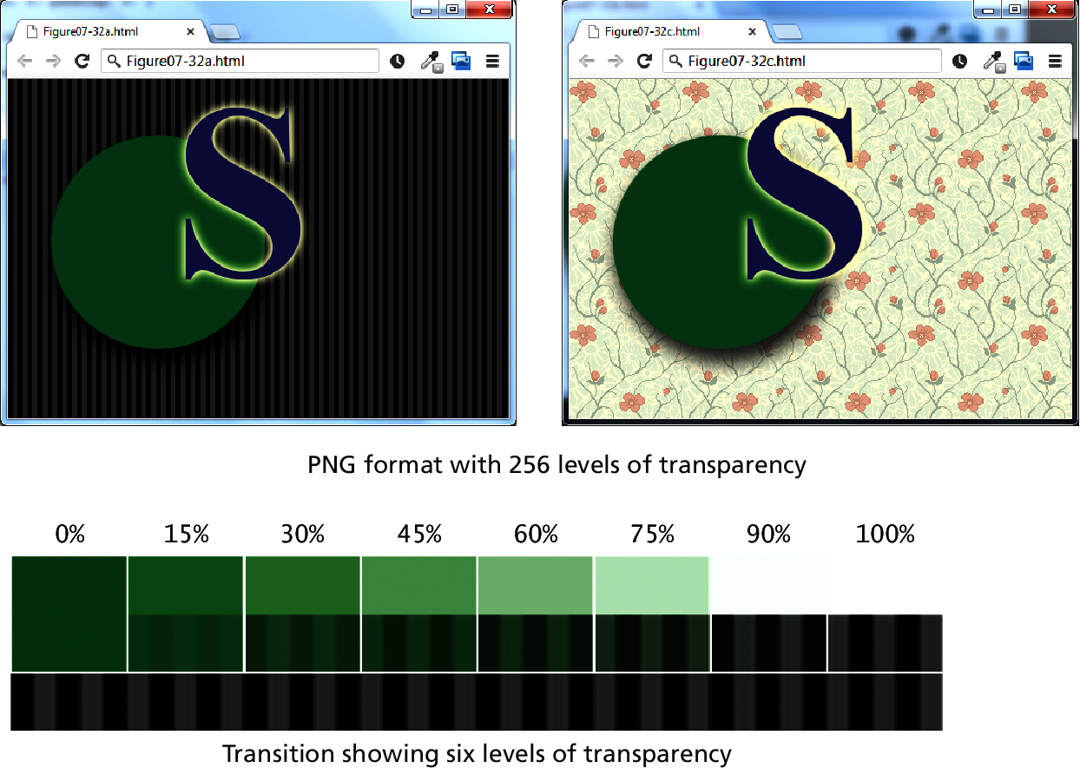
PNG
Better transparency than GIF.

Slide 66
SVG
The SVG (Scalable Vector Graphics) file format is a vector format, and now has reasonably solid browser support on the desktop
Like all vector formats, SVG graphics do not lose quality when enlarged or reduced
SVG is an open-source standard, and the files are actually XML files
SVG files end up being part of the HTML document, thus they can be manipulated by JavaScript

Slide 67
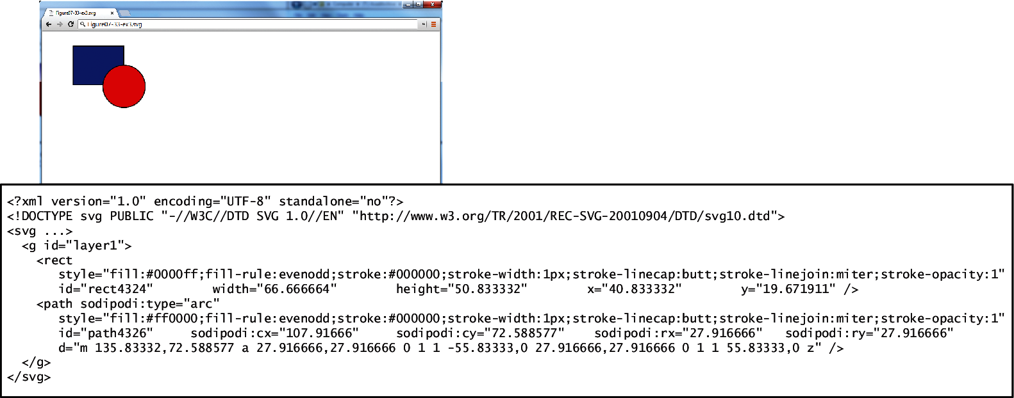
SVG
Example

Slide 68
Other Formats
There are many other file formats for graphical information, but because they cannot be viewed by browsers, we are not interested in them as web developers.

Slide 69
Audio and VIDEO
Section 5 of 6

Slide 70
Audio and Video
Until HTML5, adding audio or video to a web page typically required making use of additional, often proprietary, plug-ins to the browser
Perhaps the most common way of adding audio and video support until recently was through Adobe Flash
it is possible now with HTML5 to add these media features in HTML without the involvement of a plug-in

Slide 71
Media Concepts
If you thought that image file formats were confusing…
There are a lot of different audio and video formats, many with odd and unfamiliar names like OGG and H.264.
Two concepts are essential to understanding media formats
Media encoding
Container Formats

Slide 72
Media Encoding
AKA Media Compression
Media is encoded using compression/decompression software, usually referred to as a codec (for compression/decompression)
For web-based video, three main codecs:
H.264
Theora
VP8
For web-based audio, three main codecs:
MP3
AAC
Vorbis

Slide 73
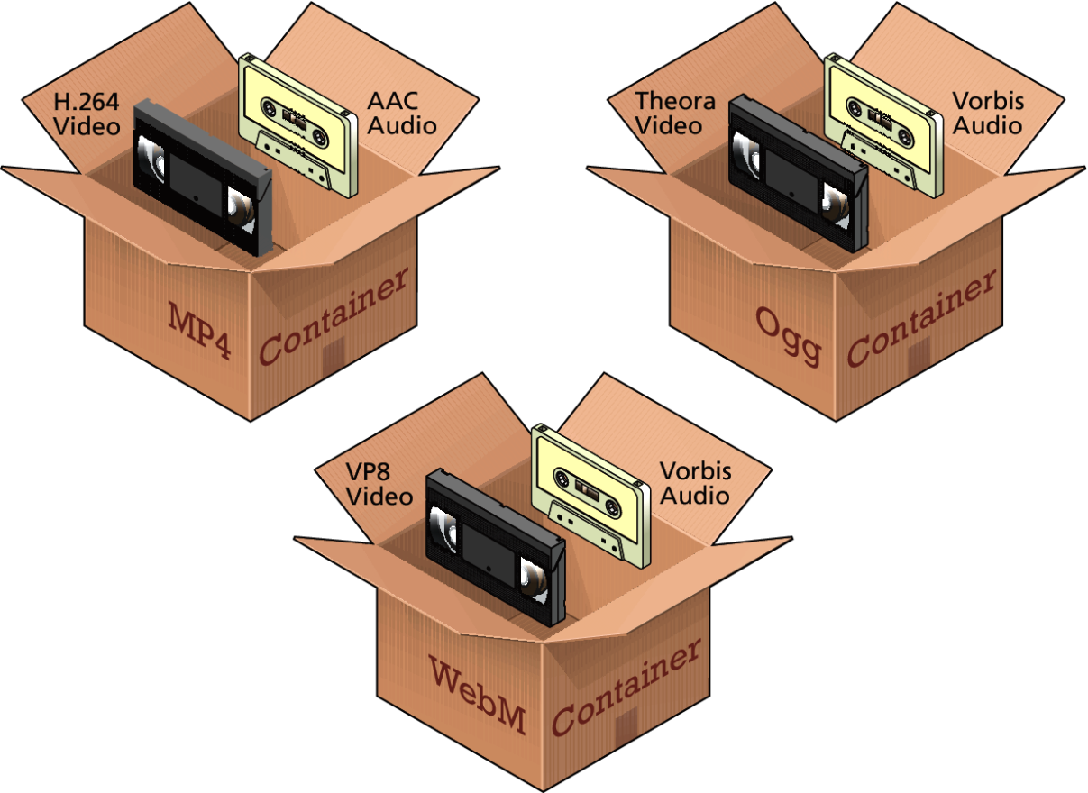
Container Formats
The container format specifies how that information is stored in a file, and how the different information within it is synchronized

Slide 74
Browser Video Support
MP4 container with H.264 Video and AAC Audio. This combination is generally referred to as MPEG-4 and has the .mp4 or .m4v file extension. H.264 is a powerful video codec, but because it is patented and because the browser manufacturer must pay a licensing fee to decode it, not all browsers support it.
WebM container with VP8 video and Vorbis audio. This combination was created by Google to be open-source and royalty free. Files using this combination usually have the .webm file extension.
Ogg container with Theora video and Vorbis audio. Like the previous combination, this one is open-source and royalty free. Files using this combination usually have the .ogv file extension.

Slide 75
Browser Video Support
Type | IE | Chrome | FireFox | Safari | Opera | Android
MP4+H.264+AAC | Y | Y | N | Y | N | N
WebM+VP8+Vorbis | N | Y | Y | N | Y | Y
Ogg+Theora+Vorbis | N | Y | Y | N | Y | N

Slide 76
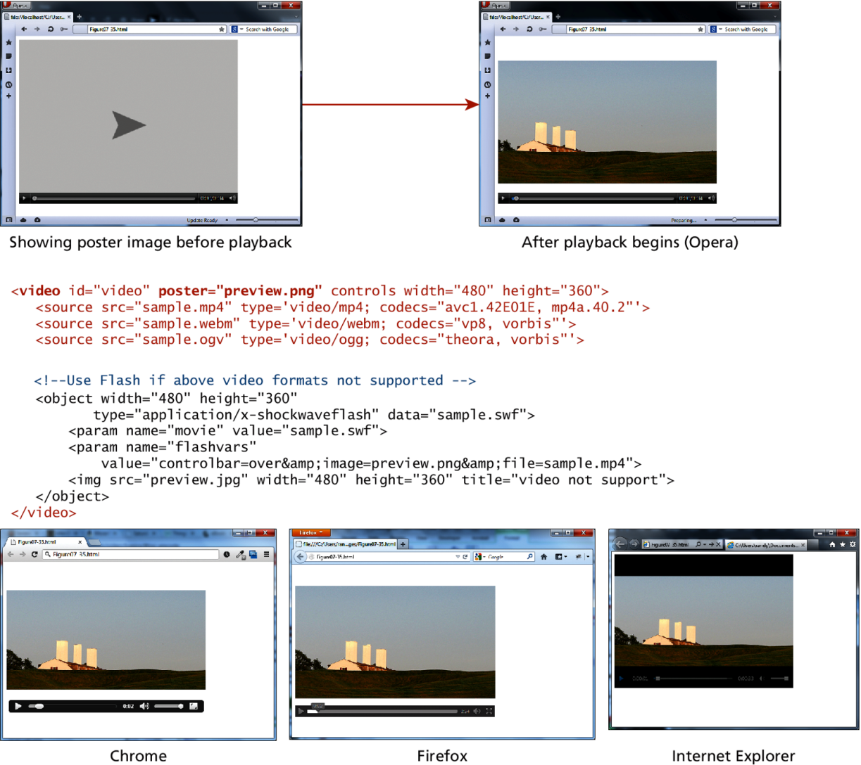
Using the <video> element

Slide 77
Browser Audio Support
MP3. Both a container format and a codec. It is patented and requires browser manufacturers to pay licensing fees. Usually has the .mp3 file extension.
WAV. Also a container and a codec. Usually has the .wav file extension.
OGG. Container with Vorbis audio. Open-source. Usually has the .ogg file extension.
Web. Container with Vorbis audio. Open-source. Usually has the .webm file extension.
MP4. Container with AAC audio. Also requires licensing. Usually has the .m4a file extension.

Slide 78
Browser Audio Support
Not all browsers are equal
Type | IE | Chrome | FireFox | Safari | Opera | Android
MP3 | Y | Y | Partial | Y | N | Y
WAV | N | Y | Y | Y | Y | Y
OGG+Vorbis | N | Y | Y | N | Y | Y
WebM+Vorbis | N | Y | Y | N | Y | Y
MP4+AAC | Y | Y | Partial | Y | N | Y

Slide 79
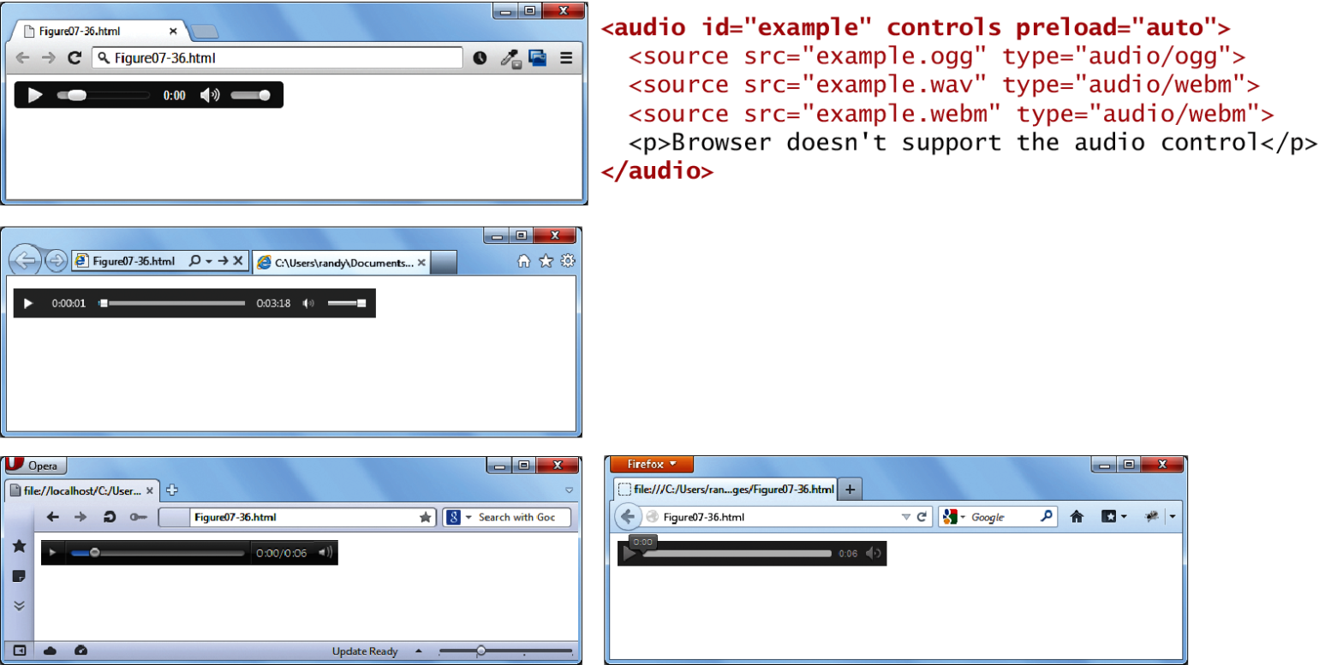
Using the <audio> element
Not all browsers are equal

Slide 80
HTML5 Canvas
Section 6 of 6

Slide 81
HTML5 Canvas
The <canvas> element is often compared to the Flash environment, since like Flash the <canvas> element can be used to create animations, games, and other forms of interactivity
There are a variety of specialized JavaScript libraries such as KineticJS, EaselJS, and Fabric.js to aid in the process of creating <canvas> and JavaScript-based sites

Slide 82
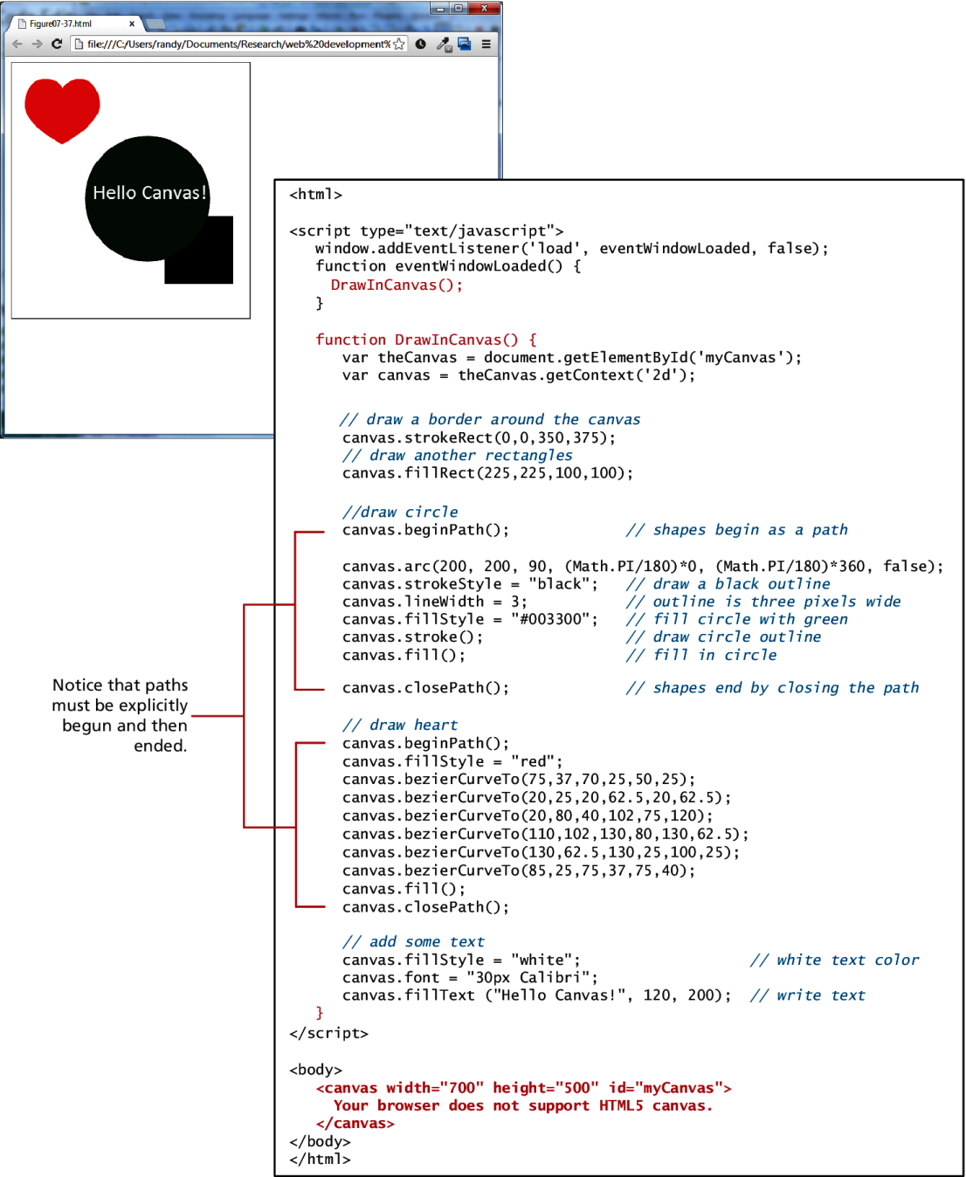
HTML5 Canvas

Slide 83
What You’ve Learned
1
2
Digital Representation
Color
Models
3
4
Image Concepts
File Formats
5
6
Audio and Video
HTML5 Canvas
7

